Slide 1

Subject Software Development Engineering Testing

Slide 2
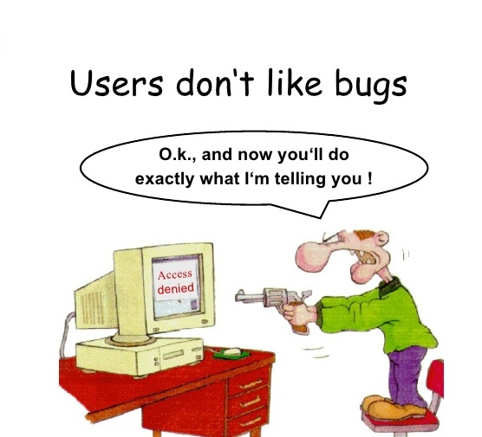
What is Software Testing?
It is not sufficient demonstrate that the software is doing what it is supposed to do.
It is more important to demonstrate that the software is not doing what it is not supposed to do.

Slide 3
What is Software Testing?
Software testing can also be stated as the process of validating and verifying that a software program/application/product: -Works as expected according to the business and technical requirements -Works consistently and predictably

Slide 4
What is Software Testing?
Process of finding defects i.e. variance between Expected results and Actual results.
Example:
If you want to test a program of addition whose output should be 2
1+1=2
1*1=2
1/1=2
1-1=2

Slide 5
Why – What – How - Who
Why to test?
What to test?
How often to test?
Who tests?

Slide 6
Why is testing necessary?
Software testing is necessary to make sure the product or application is defect free, as per customer specifications.
Testing effort is directly proportional to the complexity of the program.
More complex the program, more the testing effort is required.
Software should be: -Error Free -Efficient -Secured

Slide 7
SDLC
Software Development Life Cycle
It is used to develop the software systematically.
The seven stages of SDLC process are
Requirement Gathering
Analysis
Design
Development
Testing
Implementation
Maintenance

Slide 8
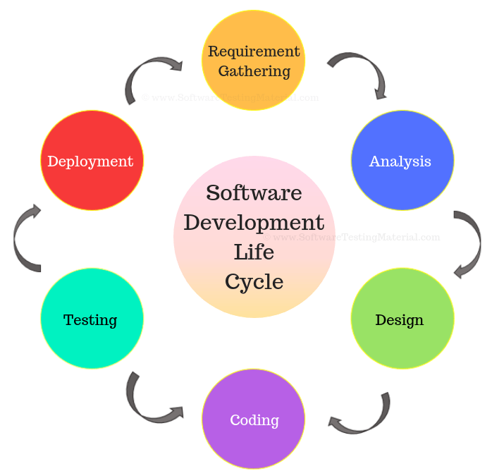
SDLC

Slide 9
SDLC
Requirement Gathering: In this phase, Business Analyst will gather all the information from the customer and prepare Business Requirement Specification (BRS) or Customer Required Specification. Senior Business Analyst will prepare System Requirement Specification (SRS) documents.
Analysis: The features and the functions that need to be put in the project are determined/analysed.

Slide 10
SDLC
Design This is done by the chief Architect; HLD and LLD are prepared.
High Level Design: Defines the overall Hierarchy of the function i.e. system architecture and design. - Interface relationship among modules. - Database tables identified along with the key element. - List of modules and a brief description of each module.

Slide 11
SDLC
Low Level Design: Defines the Internal logic of the project i.e. actual software components are implemented. - Detailed functional logic of the module. - All dependency issues Error message Listings. - Complete input and outputs for module.

Slide 12
SDLC
Development: Based on the design document, small modules are summe together and developed.
Testing: Testing phase is done by Test Engineers. Different types of testing are performed.

Slide 13
SDLC
Implementation and Maintenance: Engineers with the coordination of Developer will install / Implement the developed application. The Testing / Maintenance team will suggest to change the software if necessary.

Slide 14
SDLC Models
A few important SDLC models are as follows
Waterfall Model
Spiral Model
V Model
Agile Model-Scrum
A model depends on Client, Company and Timeline…

Slide 15
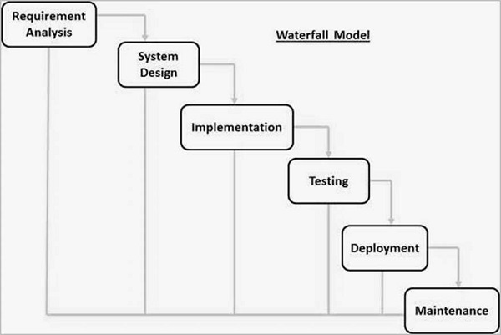
Waterfall Model

Slide 16
What is Waterfall Model?
Often considered the classic approach to the systems / software development life cycle.
Liner and sequential Model.
In this model development is seen as flowing steadily downwards (like a waterfall) through all the phases of SDLC i.e. from requirements-analysis-design-development-testing-and-so on….
Once each phase of development is completed , the development proceeds to the next phase.
There is no turning back.

Slide 17
Waterfall Advantages
Easy to understand, simple to use.
Phases are processes and completed one at a time.
Sets requirements stability.
Good for management control.
Works well for smaller projects where requirements are very well understood.

Slide 18
Waterfall Disadvantage
Adjusting scope during the life cycle can kill the project
Deliverables (Documents) created for each phase are considered frozen.
High amount of risk and uncertainty.
Poor model for complex projects.
Poor model for long and ongoing projects.

Slide 19
When to use the Waterfall Model
Requirements are very well known
Product definition is stable.
Technology is understood.
Changing an existing product to a new platform.

Slide 20
Agile Development
Agile methods break tasks into small increments with minimal planning and do not directly involve long term planning.
Each iteration involves a team working through a full software development cycle.
Used for time critical applications.

Slide 21
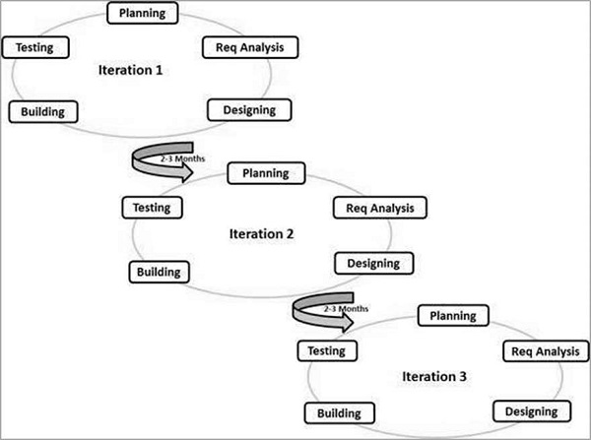
Agile Development

Slide 22
Agile Development Advantages
It speeds up the SDLC phases and bypasses steps that add little value to the project.
Regular adaptation to changing requirements.
Even late changes in requirements are welcomed.
Testing team gets early access to the software to test.

Slide 23
Agile Development Disadvantages
The project can easily get off track if developers are not clear of the final outcome.
It requires experienced resources as newbies are not capable of taking the required decisions without their support.

Slide 24
Agile-Scrum Development
Scrum is an agile way to manage a project, usually software development.
Agile software development with Scrum is often perceived as a methodology; but rather than viewing Scrum as methodology, think of it as a framework for managing a process.
In the agile Scrum world, instead of providing complete, detailed descriptions of how everything is to be done on a project, much of it is left up to the Scrum software development team

Slide 25
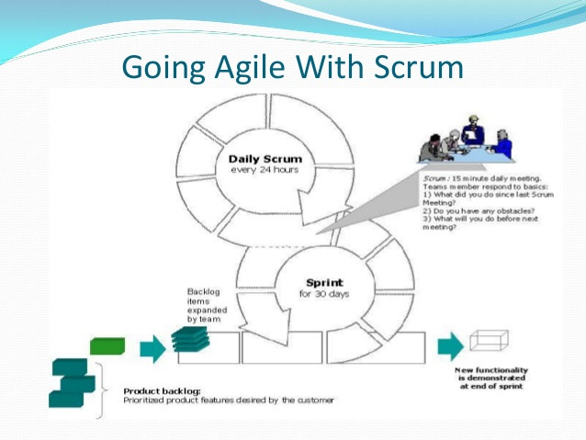
Agile-Scrum Development

Slide 26
What is the difference between Waterfall and Agile
Waterfall Model
Software development process is divided into distinct phases.
Waterfall methodology is a sequential design process.
Waterfall is a structured software development methodology so most times it can be quite rigid.
Software development will be completed as one single project.
There is no scope of changing the requirements once the project development starts.

Slide 27
What is the difference between Waterfall and Agile
Agile Model
It separates the project development lifecycle into sprints.
It follows an incremental approach
Agile methodology is known for its flexibility.
Agile can be considered as a collection of many different projects.
Agile is quite a flexible method which allows changes to be made in the project development requirements even if the initial planning has been completed.

Slide 28
Advantages of using Agile over Waterfall
The main benefit is the ability to change dynamically to the customers’ wants and needs. A focus on the features that are the highest value to the customer.
A short-fixed timeline that allows for immediate feedback from the customer and the ability to move deliverables into production.
It also is very beneficial for the teams who will be using it. Agile works well with small dedicated team members and lets the team load balance workloads.

Slide 29
Advantages of using Agile over Waterfall
Example : You may need a developer and a designer for particular project and if a person has the right experience they could be doing either type of work on an Agile team. Because Agile has more frequent check-ins and demonstrations with the business, this allows for changes to be made at a much faster pace, which is good news for smaller teams--letting them get feedback faster and making it easier for them to adjust to the wants and needs of the customer.

Slide 30
Agile in Software Development:
Agile was born when on one fine day when 17 people with differing development methodologies background, got together to brainstorm if there was a possible alternative solution to software development which could lead to faster development time and was less documentation heavy
champions of different software engineering techniques got together and the end result of their meeting was what they called the “agile manifesto’

Slide 31
Agile Challenges
The existing waterfall techniques at that time were too cumbersome and had no provision for feedback until the final product was ready to be delivered.
there was no scope for course correction and the customer had no view on the progress until the whole product was ready
agile is also about being the adaptive and continuous improvement, as much as it is about constant feedback and speed of delivery.

Slide 32
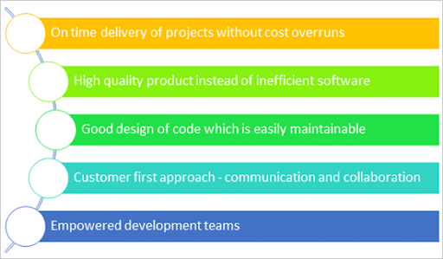
Agile Promises

Slide 33
What Exactly Is Agile?
Agile is a set of principles that encourage flexibility, adaptability, communication and a working software over plans and processes. It is very succinctly captured in what is called the agile manifesto.
Agile methods and methodologies also open a scope for process improvement as an integral part of each delivery.
Agile is a software development approach where a self-sufficient and cross-functional team works on making continuous deliveries through iterations and evolves throughout the process by gathering feedback from the end users.

Slide 34
Practice Of Agile
There are various Agile Methodologies that are in practice in various diversified industries.
However, the most popular methodologies amongst all of them are:
Scrum
Kanban
Extreme Programming
All these methodologies focus on lean software development and help in building better software effectively and efficiently.

